Slide 1
Loan Management system Harish S

Slide 2
What is Mysql?
MySQL is an open-source relational database management system(RDBMS). Its easy to use, store, organize, analyze data.
Developed by Oracle Corporation.
Uses Structured Query Language (SQL) to manage data.
Highly scalable, secure, and reliable for managing large datasets.

Slide 3
Introduction
A loan management System manages and tracks loans, customers’ details, and payments.
The project focuses on organizing data and simplifying loan tracking and management.

Slide 4
Data-sets Used
Customer Income Status
Loan Status
Customer Information
Country State
Region Information

Slide 5
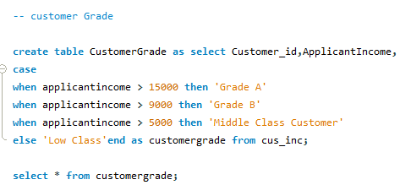
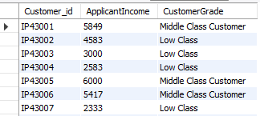
Procedure Customer Grade
Customer Grade Criteria of following query
Output

Slide 6
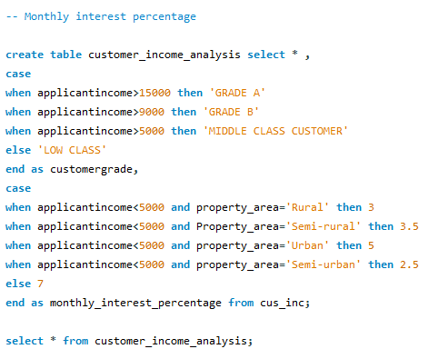
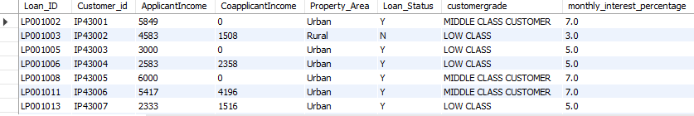
Monthly Interest percentage
Monthly Interest percentage calculation
of following query
Output

Slide 7
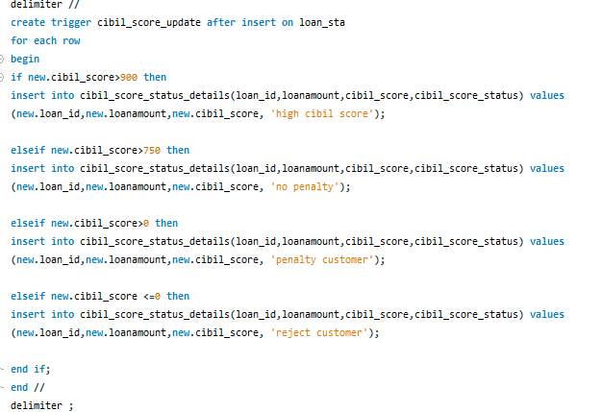
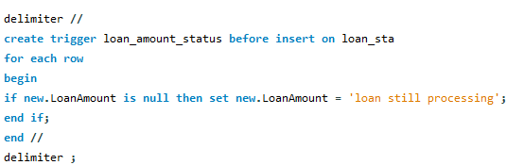
create statement level trigger for cibil score

Slide 8
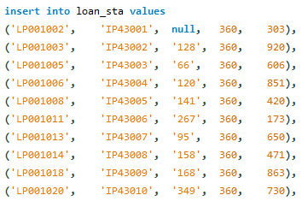
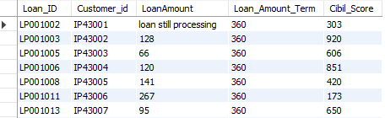
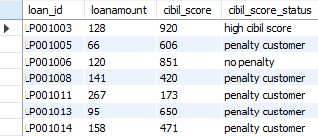
Inserted values in loan status
Loan status Output
Cibil score status details output

Slide 9
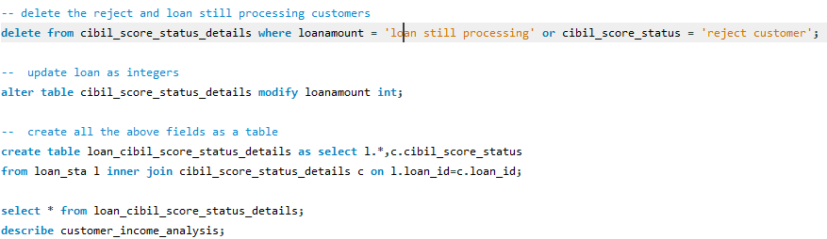
Loan processing comment and cibil score details

Slide 10
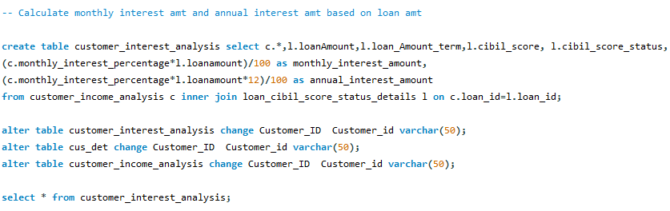
Customer interest analysis
Customer interest analysis of following query
Output

Slide 11
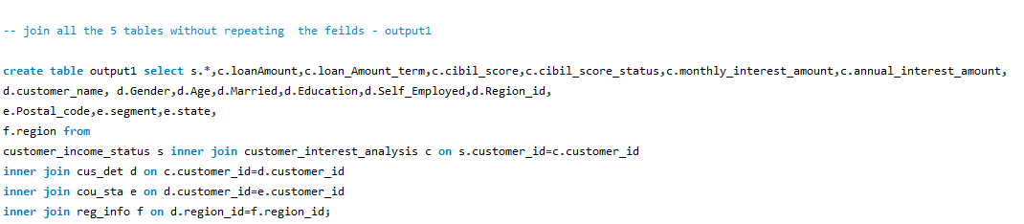
Join all the table without repeating
Output table -1 and 2

Slide 12
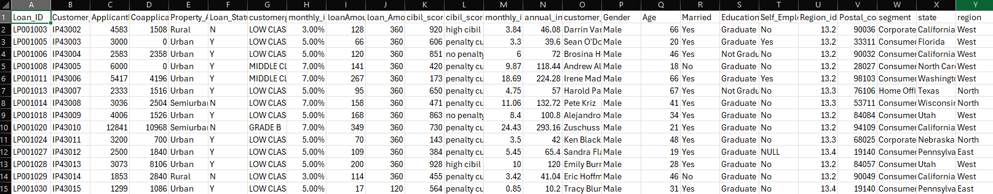
Output of output table 1and 2
Join all the 5 tables without repeating the fields - output 1 find the mismatch details using joins - output 2

Slide 13
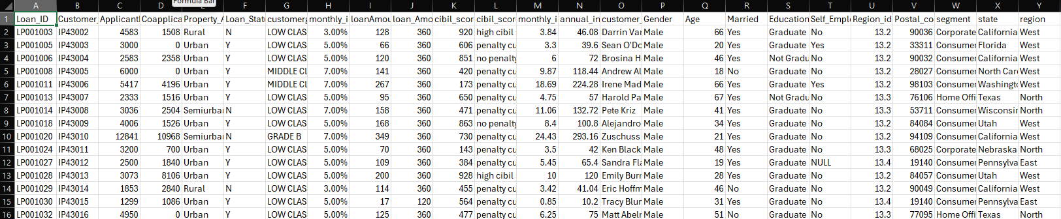
Output table 3 and 4
Filter high cibil score - output 3
Filter home office and corporate - output 4

Slide 14
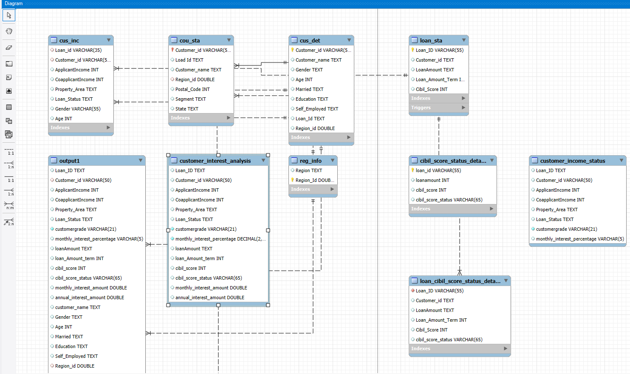
Er dIAgrAM

Slide 15
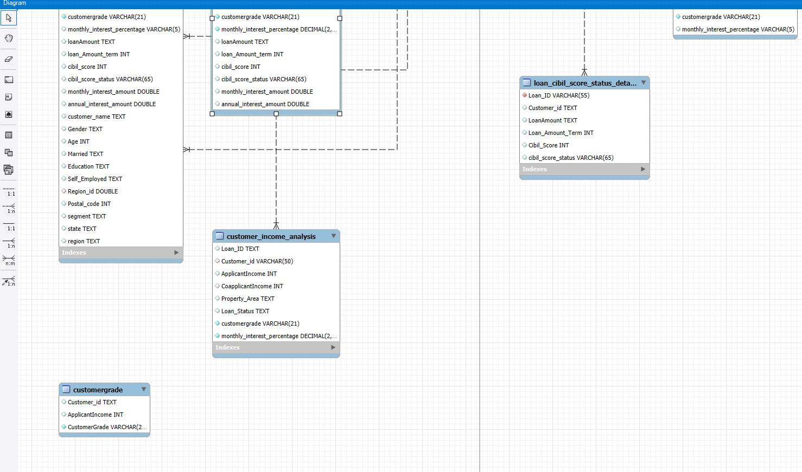
ER DIAGRAM

Slide 16
THANK YOU

